Slide 1


Lecture 13
Produced by Dr. Worldwide
Welcome to the 305
~
~

Slide 2

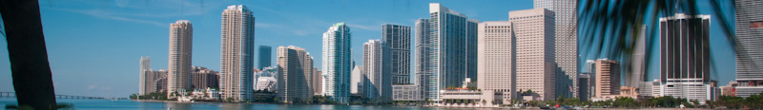
Maximal Flow Problem
Sometimes the branches in a network have limitations on the capacity
Suppose we are trying to move some resource (e.g. water, gas, oil) through a network of pipelines
Pipelines are represented as edges in a graph (directed or undirected) and each has a finite capacity that determines how much can flow through them
Source node produces the resource and a destination node receives it
Q: What is the maximum amount of flow that can be moved through the network?

Slide 3
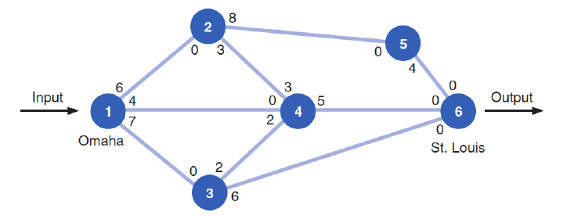
Ex: Railway System
Scott Tractor Company ships tractor parts from Omaha to St. Louis by railroad
A contract limits the number of railroad cars available on each branch
Graph of network showing the capacity (# of cars) leaving a node along an edge
Q: Is this undirected or directed?

Slide 4
Ex: Railway System
We begin by choosing an arbitrary path from the origin to the destination
A path can be defined by an ordering of nodes separated by hyphens
For example, choose the path 1-2-5-6
Q: What is the smallest capacity along this path?

Slide 5
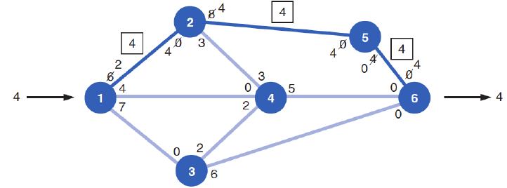
Ex: Railway System
The smallest capacity along the path is 4, corresponding to edge (5,6)
A directed edge can be defined as an ordered pair of two nodes
The capacity along the path 1-2-5-6 is 4
Update by decreasing the capacities along the edges (1,2), (2,5), and (5,6) by 4 and increasing the capacities along the edges (6,5), (5,2), and (2,1) by 4

Slide 6
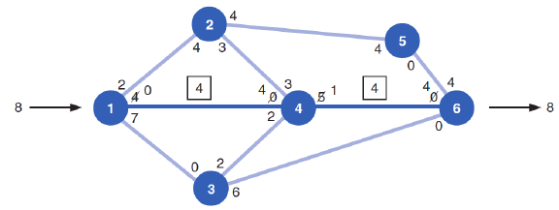

Ex: Railway System
Next, choose an arbitrary path from the updated graph
For example, choose 1-4-6
The smallest capacity is 4 because of (1,4); therefore, the capacity of 1-4-6 is 4
Update the capacities in the same way as before by decreasing in the direction 1-4-6 and increasing in the direction 6-4-1
Update maximum flow
$$4+4=8$$

Slide 7
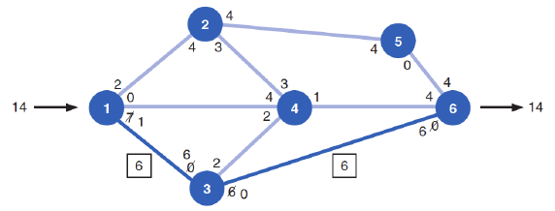

Ex: Railway System
Choose another arbitrary path from the updated graph like 1-3-6
The smallest capacity is 6 corresponding to edge (3,6)
Update the capacities according to the capacity of 1-3-6 which is 6
The maximum flow now is $4+4+6=14$

Slide 8
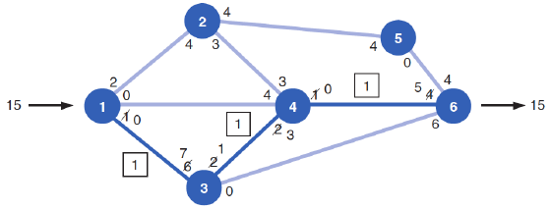
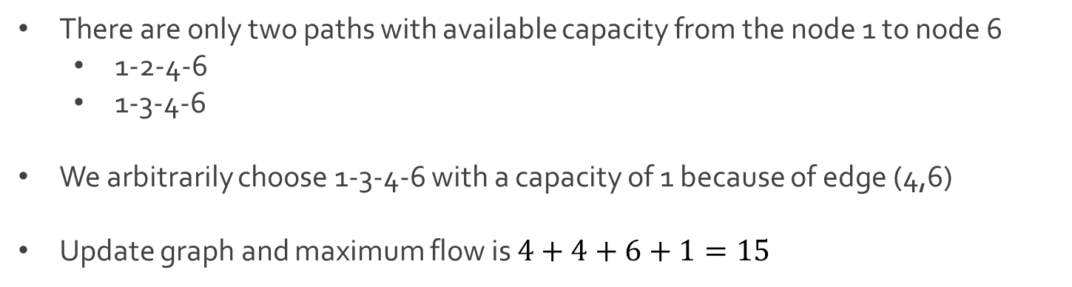
Ex: Railway System
There are only two paths with available capacity from the node 1 to node 6
1-2-4-6
1-3-4-6
We arbitrarily choose 1-3-4-6 with a capacity of 1 because of edge (4,6)
Update graph and maximum flow is $4+4+6+1=15$

Slide 9
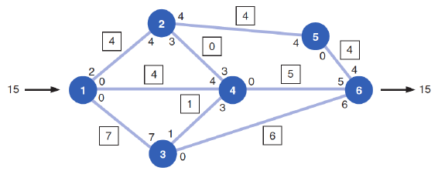
Ex: Railway System
No more paths to choose from in the updated graph
Algorithm terminates at this point
We say the maximum flow from node 1 to node 6 is 15

Slide 10
Maximal Flow Problem
Ford-Fulkerson’s algorithm for identifying the maximal flow of a network
Step 1: Arbitrarily select any path in the network from the origin to destination
Step 2: Adjust the capacities at each node by subtracting the maximal flow for the path selected in the 1st step
Step 3: Add the maximal flow along the path in the opposite direction
Step 5: Repeat previous steps until there are no more paths with flow capacity

Slide 11
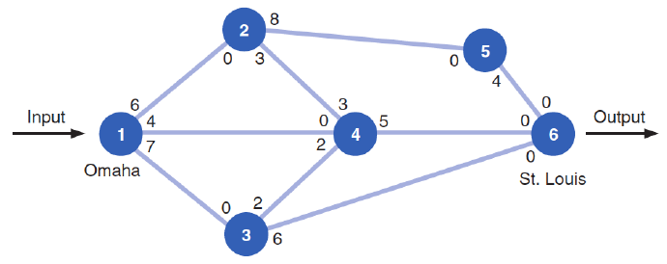
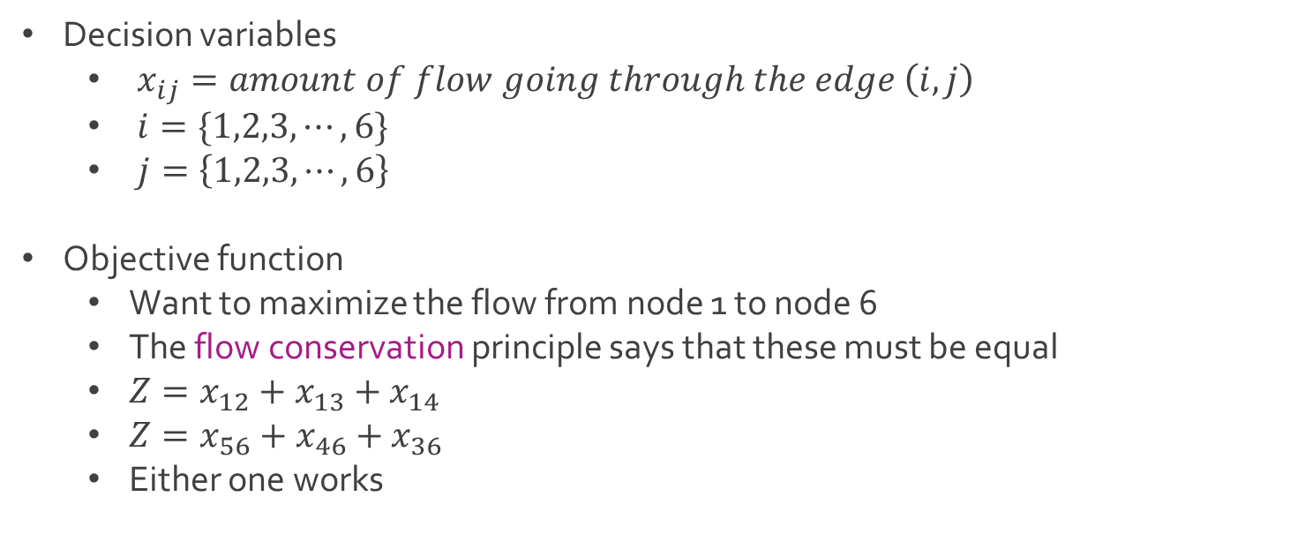
Ex: Railway System
Decision variables
$x_{ij}=amount of flow going through the edge \left(i,j\right)$
$i=\{1,2,3,⋯, 6\}$
$j=\left\{1,2,3,⋯,6\right\}$
Objective function
Want to maximize the flow from node 1 to node 6
The flow conservation principle says that these must be equal
$Z=x_{12}+x_{13}+x_{14}$
$Z=x_{56}+x_{46}+x_{36}$
Either one works

Slide 12
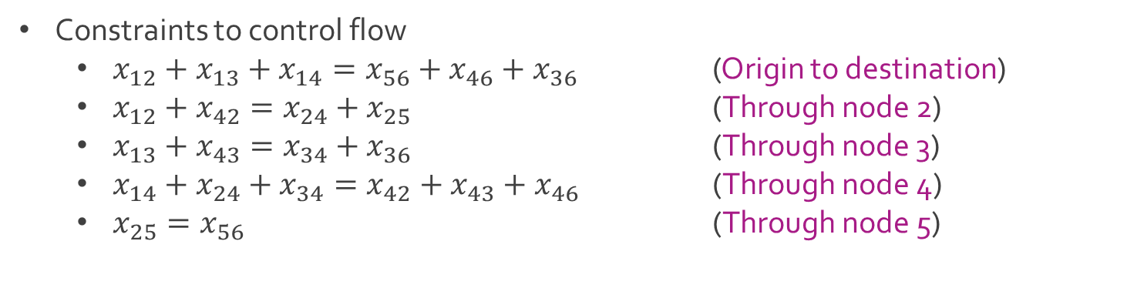
Ex: Railway System
Constraints to control flow
$x_{12}+x_{13}+x_{14}=x_{56}+x_{46}+x_{36}$ (Origin to destination)
$x_{12}+x_{42}=x_{24}+x_{25}$ (Through node 2)
$x_{13}+x_{43}=x_{34}+x_{36}$ (Through node 3)
$x_{14}+x_{24}+x_{34}=x_{42}+x_{43}+x_{46}$ (Through node 4)
$x_{25}=x_{56}$ (Through node 5)

Slide 13

Ex: Railway System
Constraints to control capacity
$x_{12}≤6$
$x_{13}≤7$
$x_{14}≤4$
$x_{24}≤3$
$x_{25}≤8$
$x_{34}≤2$
$x_{36}≤6$
$x_{42}≤3$
$x_{43}≤2$
$x_{46}≤5$
$x_{56}≤4$
Constraints to control domain
$x_{ij}∈\{0,1,2,3,⋯\}$

Slide 14
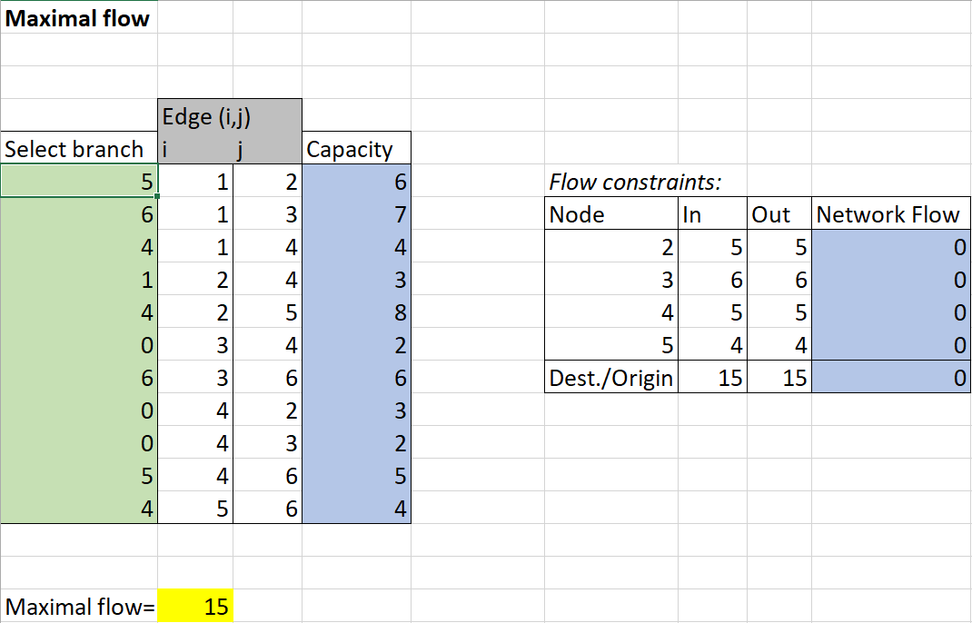
Ex: Railway System
Download MaximalFlow.xlsx from course website from link Sheet 1
=A12+A15+A16

Slide 15
Minimal Spanning Tree
Like the shortest route problem where goal was to find the shortest path from a single origin to all other nodes in a network
The minimal spanning tree is the set of edges having the minimum total length that connects all the nodes in the network
A minimal spanning tree has no origin node

Slide 16
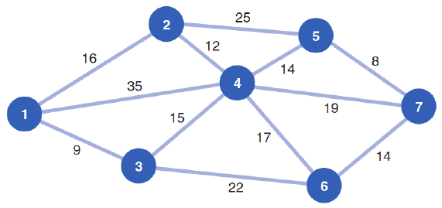
Ex: Cable Company
Cable company wants to connect all 7 houses in a neighborhood
Network shows length of cable in feet required for each possible path
Q: What is the shortest path that spans (connects) all the houses?

Slide 17
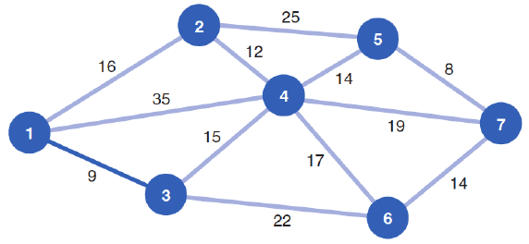
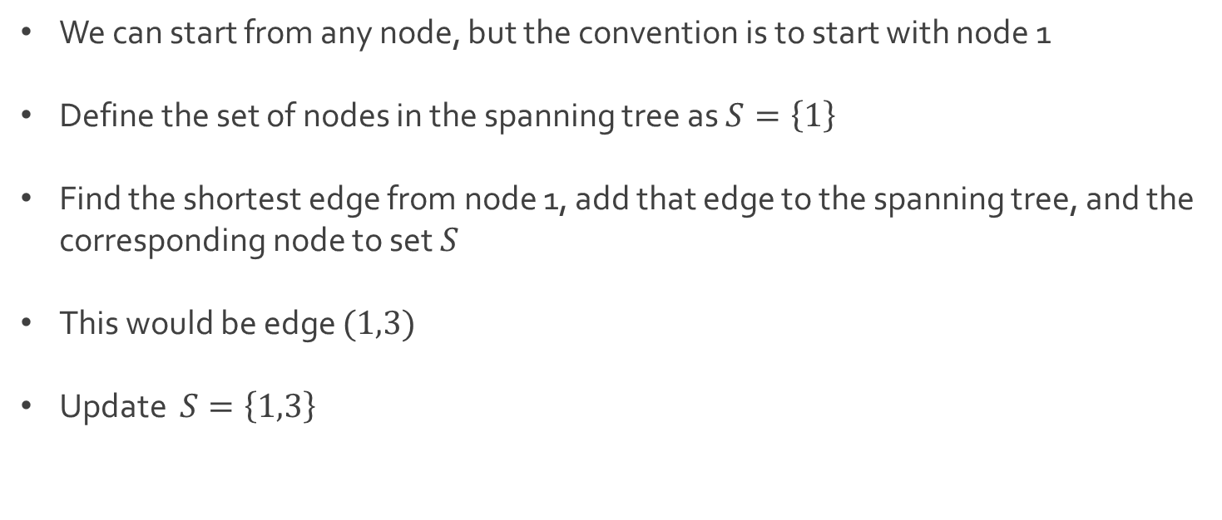
Ex: Cable Company
We can start from any node, but the convention is to start with node 1
Define the set of nodes in the spanning tree as $S=\left\{1\right\}$
Find the shortest edge from node 1, add that edge to the spanning tree, and the corresponding node to set $S$
This would be edge $(1,3)$
Update $S=\left\{1,3\right\}$

Slide 18
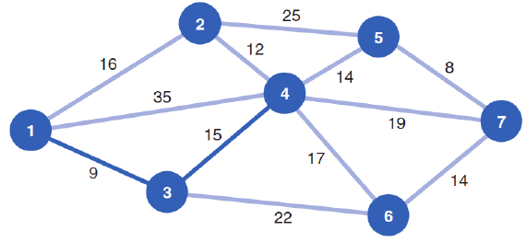
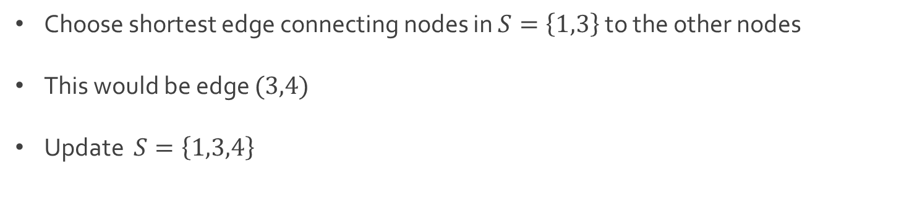
Ex: Cable Company
Choose shortest edge connecting nodes in $S=\left\{1,3\right\}$ to the other nodes
This would be edge $(3,4)$
Update $S=\left\{1,3,4\right\}$

Slide 19
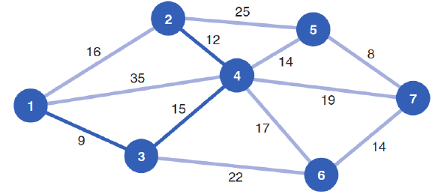
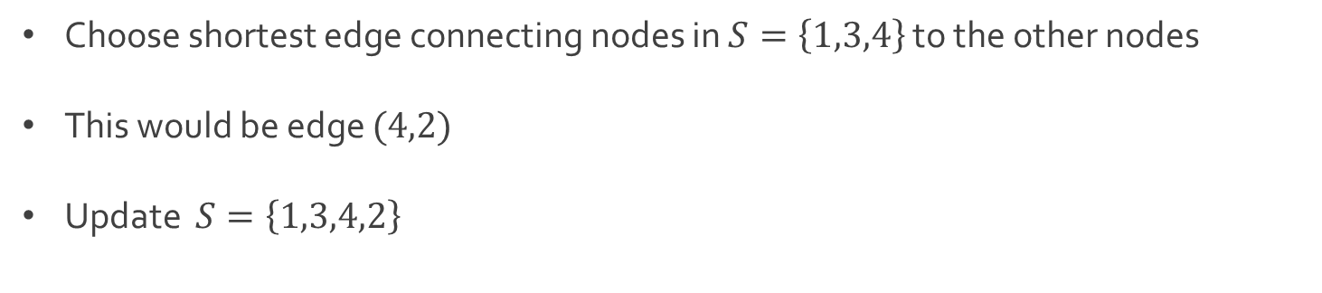
Ex: Cable Company
Choose shortest edge connecting nodes in $S=\left\{1,3,4\right\}$ to the other nodes
This would be edge $(4,2)$
Update $S=\left\{1,3,4,2\right\}$

Slide 20
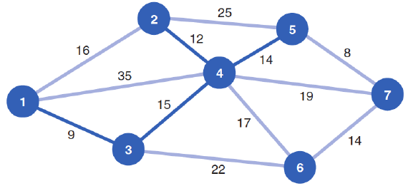
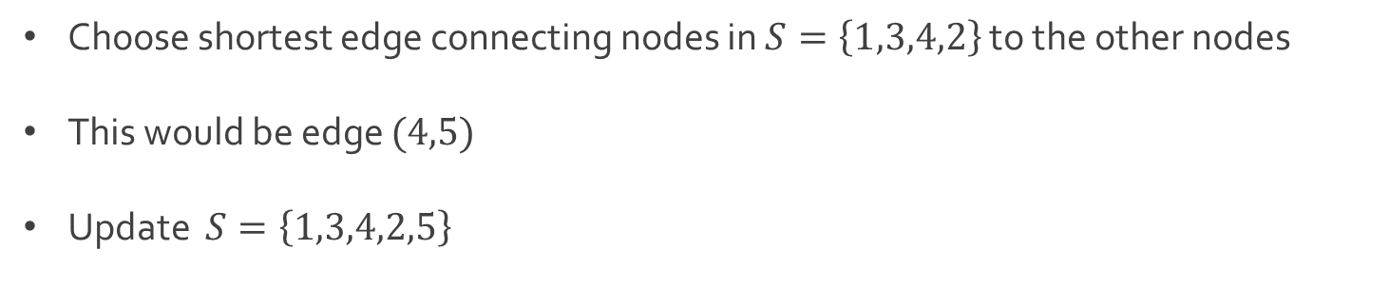
Ex: Cable Company
Choose shortest edge connecting nodes in $S=\left\{1,3,4,2\right\}$ to the other nodes
This would be edge $(4,5)$
Update $S=\left\{1,3,4,2,5\right\}$

Slide 21
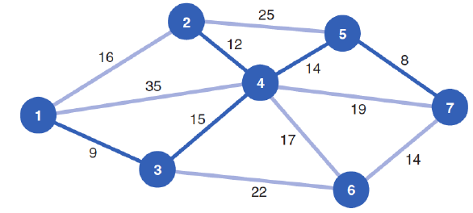
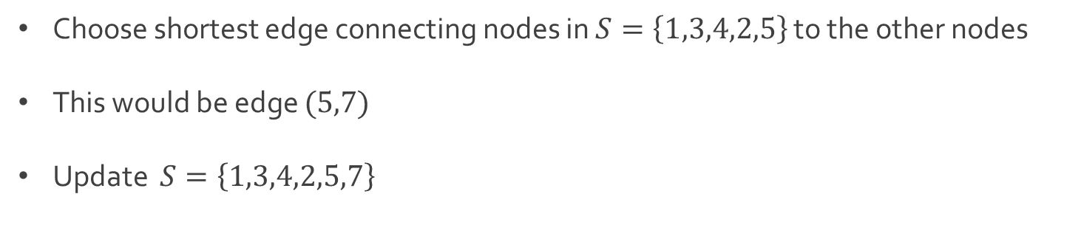
Ex: Cable Company
Choose shortest edge connecting nodes in $S=\left\{1,3,4,2,5\right\}$ to the other nodes
This would be edge $(5,7)$
Update $S=\left\{1,3,4,2,5,7\right\}$

Slide 22
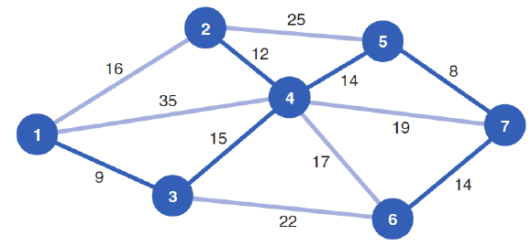
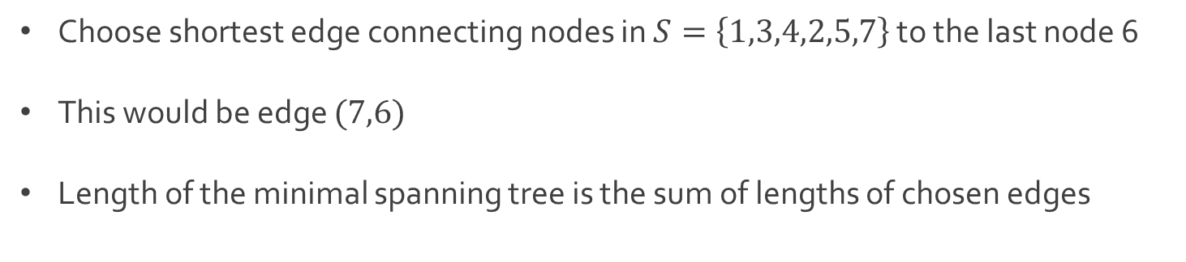
Ex: Cable Company
Choose shortest edge connecting nodes in $S=\left\{1,3,4,2,5,7\right\}$ to the last node 6
This would be edge $(7,6)$
Length of the minimal spanning tree is the sum of lengths of chosen edges
$$9+15+12+14+8+14=72$$

Slide 23
Minimal Spanning Tree
Prim algorithm for identifying the minimal spanning tree
Step 1: Select an arbitrary node to start (usually node 1)
Step 2: Select the node closest to the starting node to join the spanning tree
Step 3: Select the closest node not currently in the spanning tree
Step 4: Repeat the 3rd step until all nodes have joined the spanning tree

Slide 24




The End
Dale

